Slide 1

Name | Student ID
Mahmudul Hasan Shihan | 2221081098
Abdur Razzzak | 2221081081
Nure Alam Akond Shadin | 2221081095
Nusrat Tabassum | 2221081101
20/05/24

Slide 2

Data Communication
Connecting the Digital World

Slide 3
Introduction
Component of Data Communication
Types of Data Transmission
4
Outline-
Transmission Media
Types of Data Communication
YOUR TITLE
Why Data Communication
Conclusion

Slide 4


Introduction -
What is Data?
It includes information like age, time, height, weight, etc.
What is Communication?
Communication is a process that involves sending and receiving messages through the verbal and non-verbal methods.

Slide 5

What is Data Communication?
Data communication refers to the process of transmitting and receiving data between two or more devices over a communication channel.
Message
Protocol
Protocol
Sender
Receiver
Transmission Medium

Slide 6

Components of Data Communication
Message
A message is a piece of information that is to be transmitted from one person to another.
Sender
It is simply a device that sends data messages. It can be a computer, mobile, telephone, laptop, video camera, or workstation, etc.
Receiver
It is a device that receives messages. It can be a computer, telephone mobile, workstation, etc.
Transmission Medium
Communication channels are the medium that connect two or more workstations.
Protocol
When someone sends the data, it should be understandable to the receiver also otherwise it is meaningless.

Slide 7
Types of
Data Transmission
There are two types of Data Transmission
Analog Transmission
Digital Transmission

Slide 8
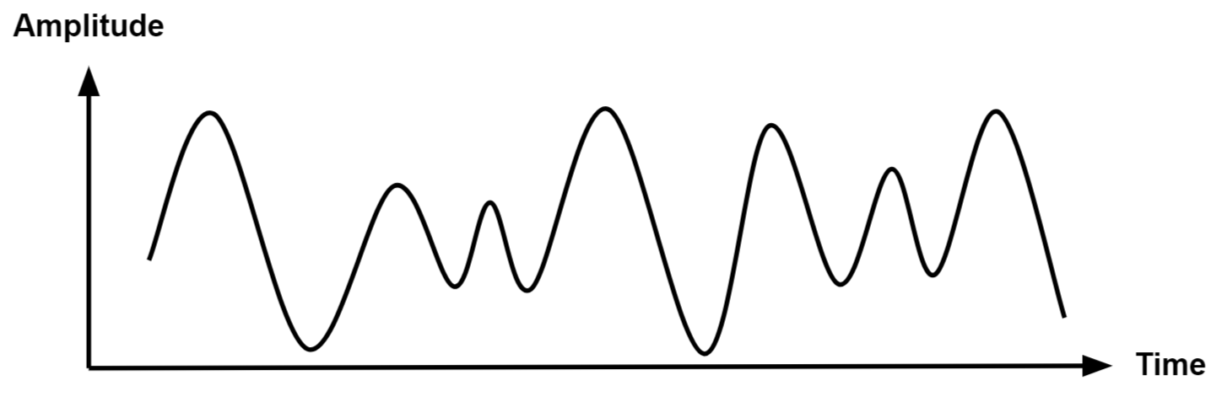
Analog Transmission
Analog data transmission involves the transfer of data in a continuous signal across
the time. For example, when we speak into a landline telephone, our voice is
converted into an analog electrical signal that travels through the telephone
network to the receiver.

Slide 9
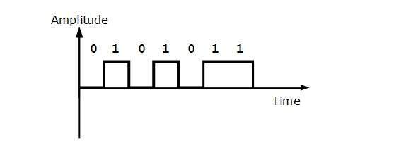
Digital Transmission
Digital data transmission involves the transfer of data using discrete signals,
typically represented as binary code (a series of 0s and 1s). For example,
when we send an email, the content is broken down into packets of binary data.

Slide 10
Transmission Media
There are two types of Transmission Media
Wired Media
Wireless Media

Slide 11
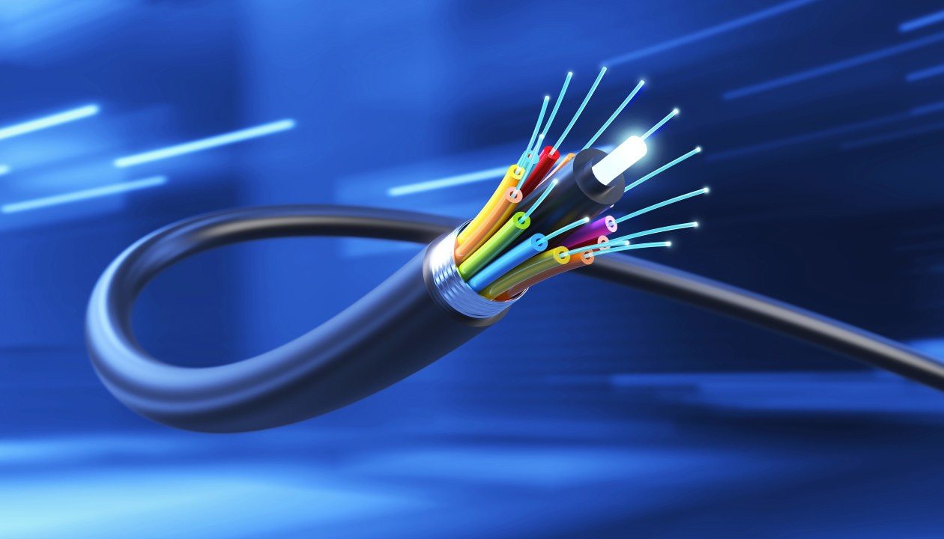
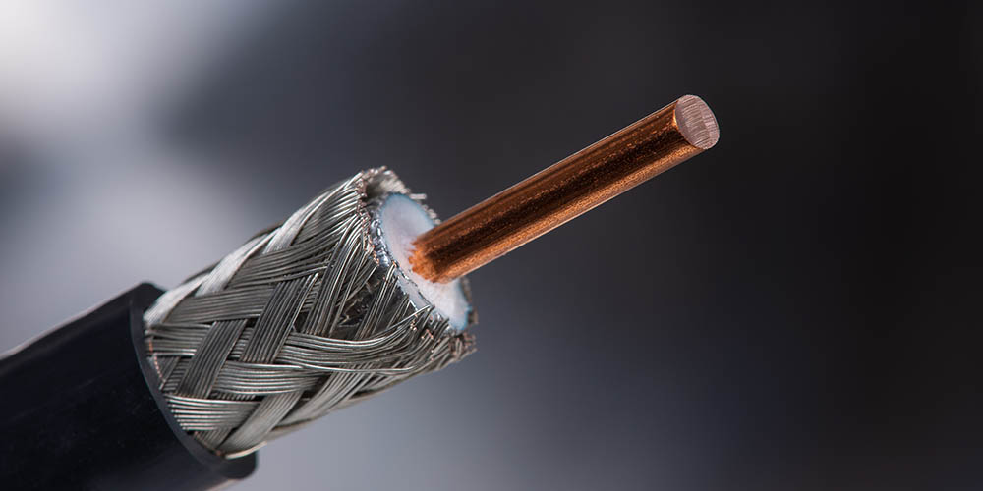
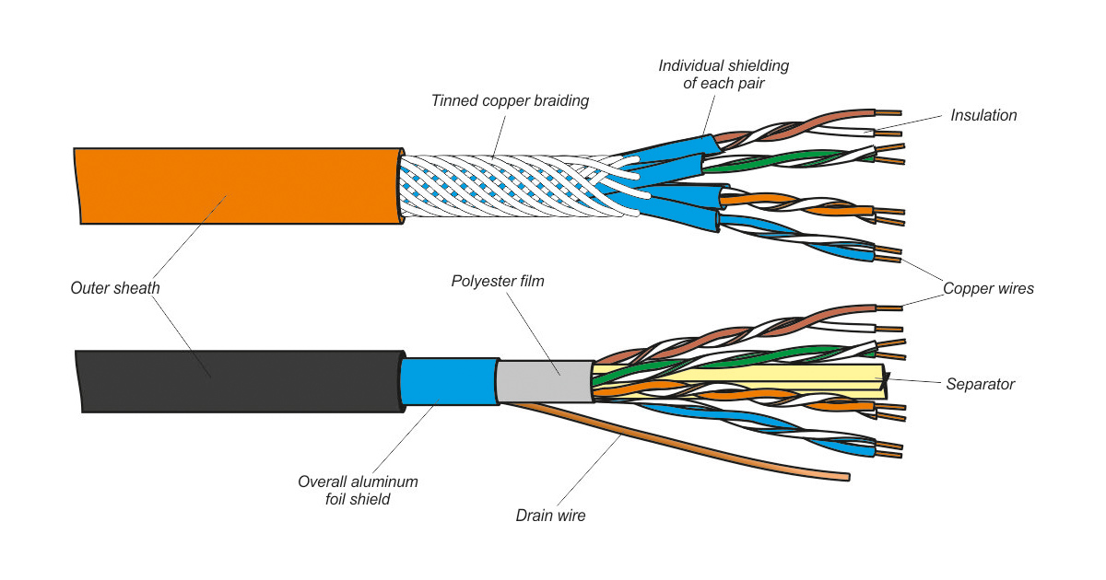
Wired Media
Wired media refers to the physical cables and wires,
used to transmit data between two or more devices.
There are three types of wired media
Twisted Pair Cable
Coaxial Cable
Optical Fiber Cable

Slide 12

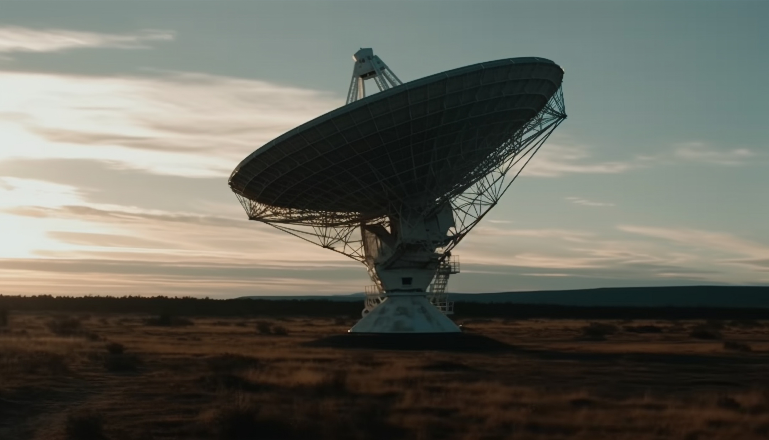
Wireless Media
Wireless media refers to the transmission of data through the air using electromagnetic waves, without the need for physical cables. This method provides greater flexibility and mobility.
There are some wireless media such as-
Micro Wave
Radio Wave
Infrared

Slide 13
Type of data communication
The data communication is divided into three types:
Simplex
Half-Duplex
Full-Duplex

Slide 14
Simplex Communication
It is one-way communication or we can say that unidirectional communication,
Where one device only receives and another device only sends data.
For example, entering data using a keyboard.
Sender
Receiver

Slide 15
Half-Duplex Communication
It is a two-way communication, or we can say that it is a bidirectional communication
Where both devices can send and receive data but not at the same time.
For example, walkie-talkie.
Sender
Receiver

Slide 16
Full-Duplex Communication
It is a two-way communication or we can say that it is a bidirectional communication
where both devices can send and receive data at the same time.
For example, mobile phones, landlines, etc.
Sender
Receiver

Slide 17
Why Data Communication
Basically, data communication is crucial in our daily life for several reasons
Enhanced Communication
Efficient Business Operations
Enhance Educational Knowledge
Smart Technology
Use Smart Medical Technology

Slide 18
Conclusion
In conclusion, data communication is essential for transmitting information between devices, forming the backbone of our digital world. We've covered the basics, including transmission media, data transmission techniques and protocols.

Slide 19
Thanks

